Slide 1
HHX
Case

Slide 2
Markedet

Slide 3
struktur
Total markedet
B2B - Kontrakt
Tæpperuller
(55 %)
Tæppefliser
(45 %)
B2C - Bolig

Slide 4
b2b

Slide 5
De største
Producenter / Produktionslokationer | US | ANZ | EU | ASIA | UK
Mohawk | ●
Shaw | ● |  |  | ●
Interface | ● | ● | ● | ● | ●
Tarkett/Desso | ● |  | ● | ●
Milliken | ● | ● |  | ● | ●

Slide 6
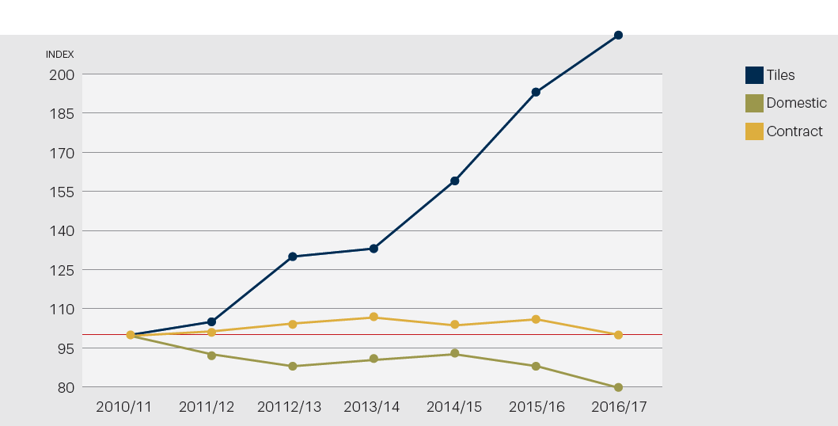
EGE

Slide 7
SEGMENTS
20 % salg i hjemmemarkedet (DK) / 80 % Eksportsalg

Slide 8
Internationalisering

Slide 9
Ege udvikling
Hjemmemarked
DK
Nabomarkeder
SE
Fjernmarkeder
MEA
NO
DE
UK
FR
ASIA
Americas

Slide 10
markedsfokus
Priority |  | Markets | Segments | Product types
Primary | Retain | Denmark Norway Sweden |  | Broadloom
 | Grow | DACH France The UK | Hospitality Commercial | Tiles
 | Other | Americas Far East Middle East | Domestic - DK Public (Commercial appendix) Healthcare - UK Aviation (globally)
Potential |  | Holland, Italy, Spain
Secondary |  | Finland, Poland, Russia | Entertainment | Commodities

Slide 11
The change type

Slide 12
Marketingmix

Slide 13
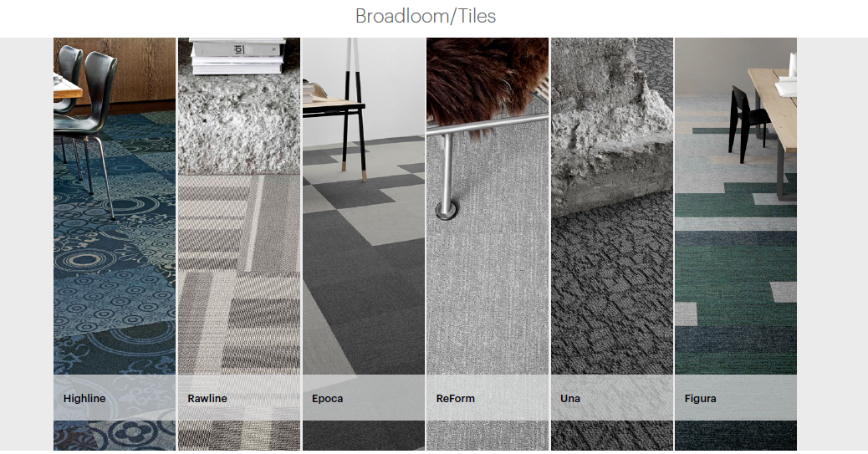
Produkter

Slide 14
Danish design

Slide 15
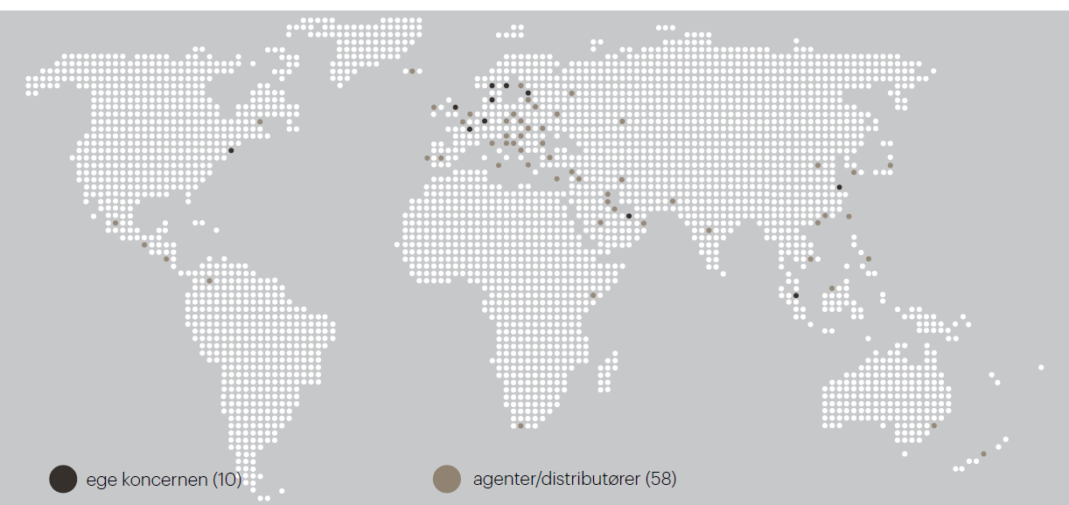
distributionskanaler

Slide 16
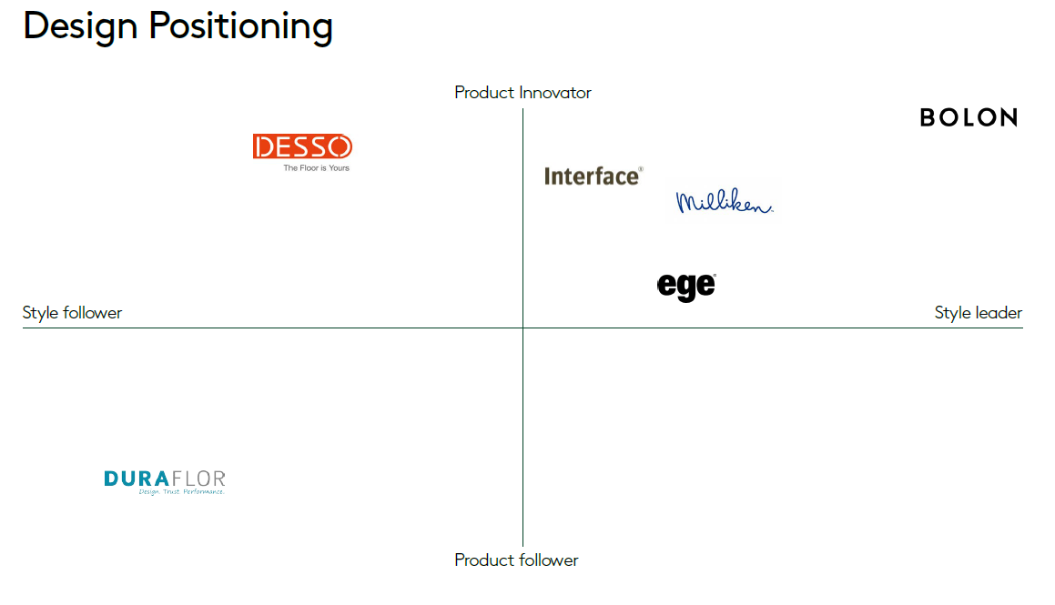
position

Slide 17
Q & A

